Slide 1
The Late Devonian Extinction
Ryan Olsen
GO325 (Earth History)
Fall, 2020

Slide 2
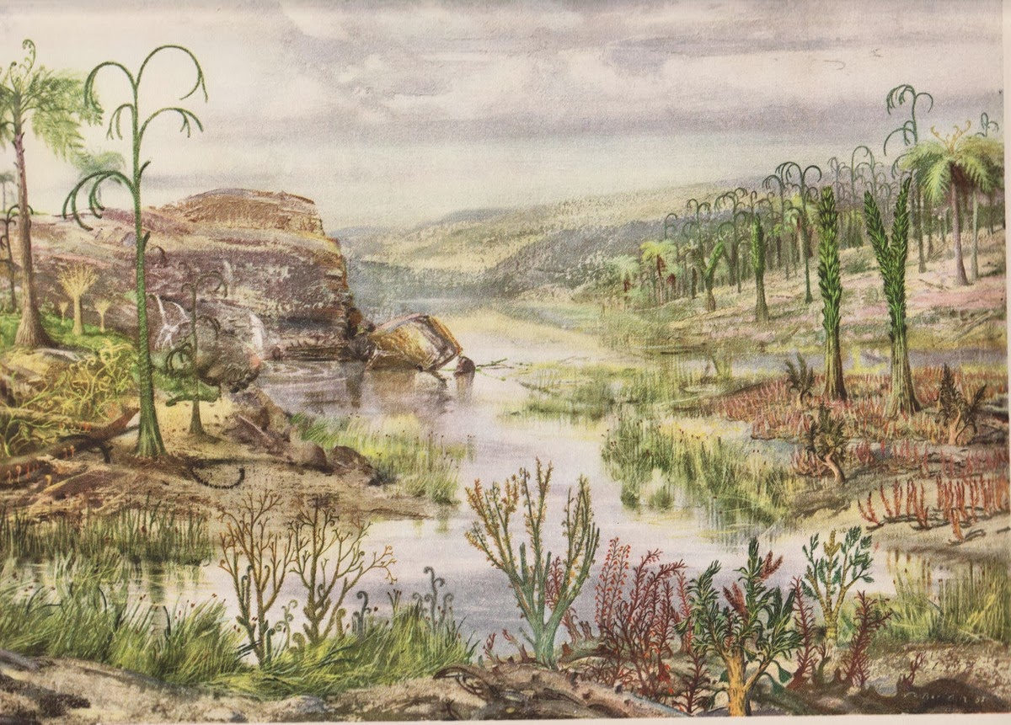
The Late Devonian Extinction
The Devonian Period
Extinction Events
Aftermath
Conclusion
DEVONIAN PERIOD - Zdenek Burian, 1956

Slide 3
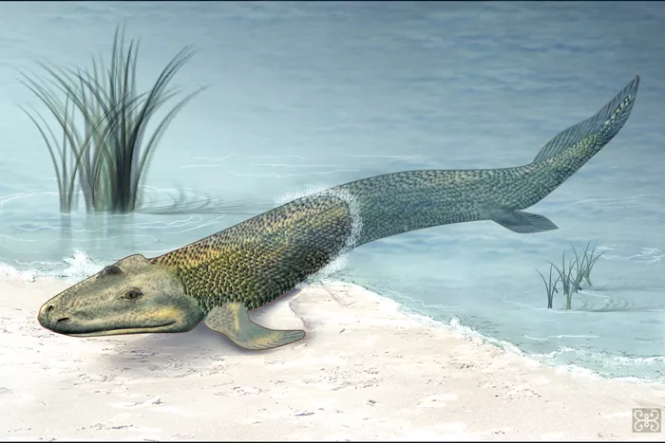
The Devonian Period
419.2 - 358.9 Mya
Age of Fishes
“Fishapods”
High Biodiversity
Tiktaalik rosae - Zina Deretsky, National Science Foundation, date unknown
Notes:
To paraphrase Aron Ra, this is when fish learned to salamander

Slide 4
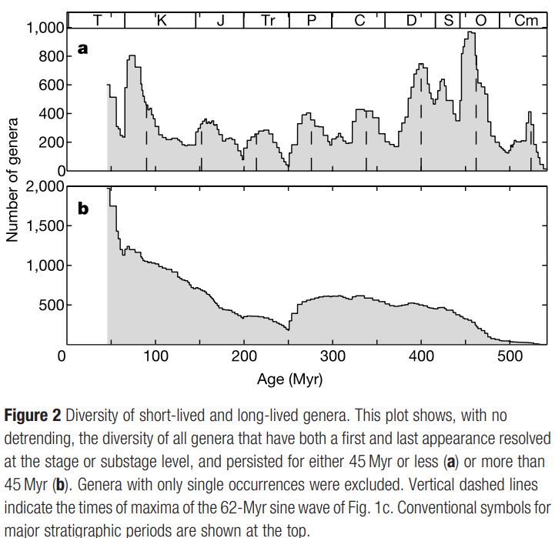
The Devonian Period
Rohde and Muller, 2005

Slide 5
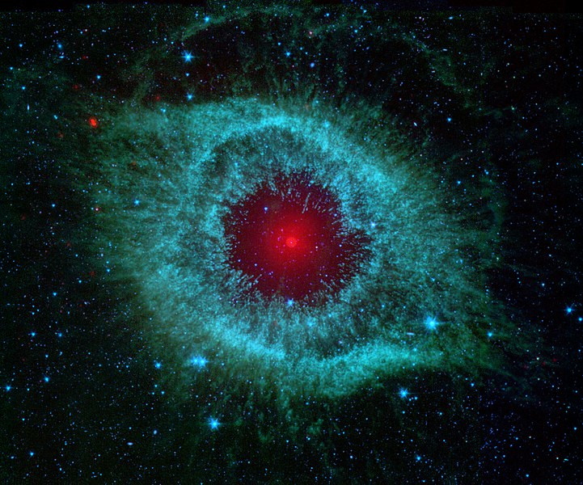
Cause - Astrophysical
Bolide impacts
Supernova
Solar proton events
Gamma-ray burst
Neutron star merger
Helix Nebula, NASA / JPL-Caltech / Univ. of Ariz., 2007. https://www.nasa.gov/mission_pages/spitzer/multimedia/pia09178.html

Slide 6
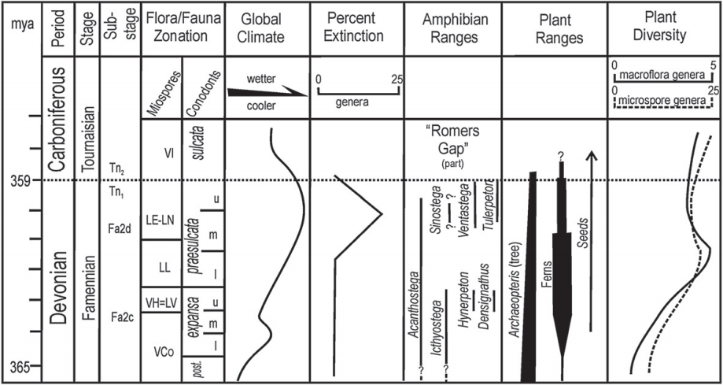
Cause - Long-Term Climate Change
Glaciation
Ozone depletion
Volcanic activity
Sea level change
Decrease of CO₂
Correlation of Late Devonian climate and biotic change. D.K. Brezinski et al., 2009.

Slide 7
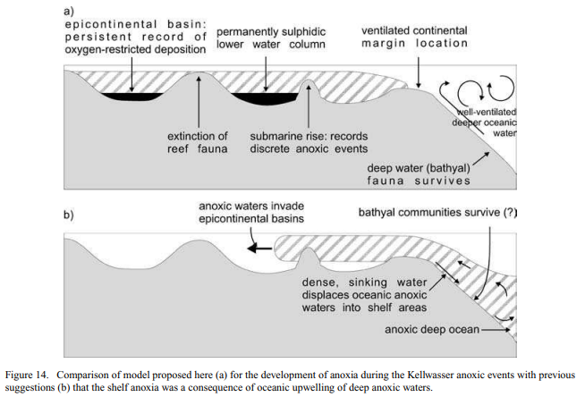
Cause - Anoxic events
Oceanic upwelling
Bond et. al., 2004.

Slide 8
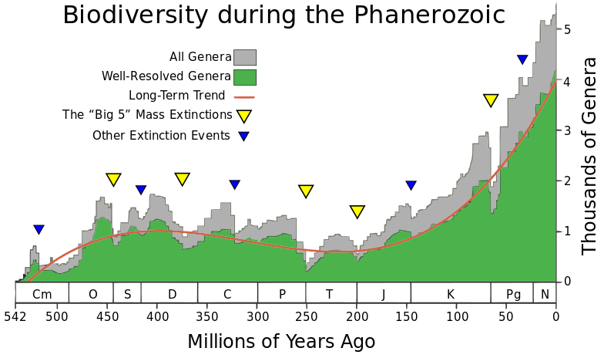
Aftermath
Long term effect on biodiversity
Biodiversity did not recover until the Cretaceous
Biodiversity during the Phanerozoic. (Mestre, 2008). Adapted from Rohde and Muller (2005).

Slide 9
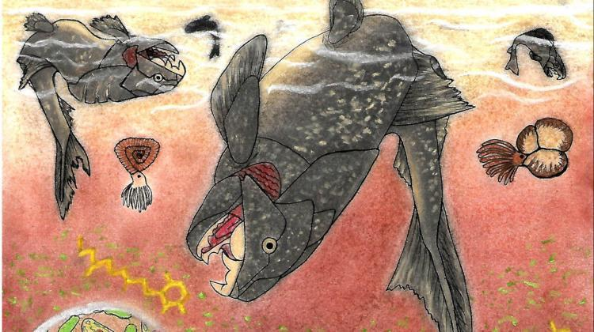
The Late Devonian Extinction
The Devonian Period
Extinction Causes
Aftermath
Conclusion
Karolina Paszcza, unknown date. https://scienceinpoland.pap.pl/en/node/82147

Slide 10
References
Bond, D.P.G., Wignall, P.B., 2008. The role of sea-level change and marine anoxia in the Frasnian-Famennian (Late Devonian) mass extinction, European Urology, vol. 263 no. 3-4 , p.107 - 118.
Bond, D.P.G., Wignall, P.B. and Racki, G., 2004. Extent and duration of marine anoxia during the Frasnian– Famennian (Late Devonian) mass extinction in Poland, Germany, Austria and France. Geological Magazine, vol. 141 no. 2. p. 173-193.
Brezinski, D., Cecil, C. B., Skema, V. w., Kertis, C. A., 2009. Evidence for long-term climate change in Upper Devonian strata of the central Appalachians, Palaeogeography, Palaeoclimatology, Palaeoecology. 284:(3-4), 315-325.
De Vleeschouwer, D., Da Silva, A. C., Sinnesael, M., Chen, D., Day, J.E., Whalen, M. T., Gou, Z., Claeys, P. 2017. Timing and pacing of the Late Devonian mass extinction event regulated by eccentricity and obliquity, Nature Communication. vol. 8, article 2268, p. 1-11
Fields, B. D., Melott, A. L, Ellis, J, Ertel, A.F., Fry, B. J., Lieberman, B. S., Lui, Z., Miller, J. A., Thomas, B. C., 2020. Supernova triggers for end-Devonian extinctions, PNAS. 117:35, 21008-21010.
Kravchinsky, V. A., Konstantinov, K. M., Courtillot, V., Savrasov, J. I., Valet, JP., Cherniy, S. D., Mishenin, S. G., Parsotka, B. S., 2001. Palaeomagnetism of East Siberian traps and kimberlites: two new poles and palaeogeographic reconstructions at about , 360 and 250 Ma, Geophysics Journal International, 148, 1-33.
McGhee Jr., G. R., 1988. The Late Devonian extinction event: evidence for abrupt ecosystem collapse, Paleobiology. vol. 14, no. 3, p 250-57
Mestre, A, 2008. Phanerozoic Biodiversity.svg. <https://commons.wikimedia.org/wiki/File:Phanerozoic_Biodiversity.svg>, accessed Nov 5, 2020.
Rohde, R. A., Muller, R. A., 2005. Cycles in fossil diversity, NATURE, vol. 434. P. 208-210.

